Slide 1
Here is how you write the perfect motivational letter

Slide 2
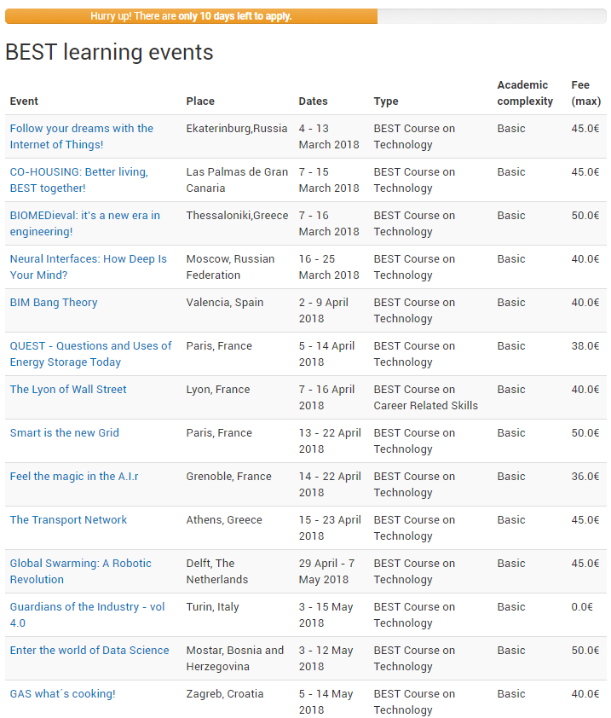
Step 1: Choose your course
You can apply for up to 3 courses
The application consist of
Motivational letter
3 questions
Deadline: 26th of Nov. at 23.00
Confirmation: 17th of Dec. at 23.00

Slide 3
Step 2: What should you write?
Think about
Why do you want to go to this course/city/country?
What do you want to gain from the course?
What do organizers want to gain from this course?

Slide 4
Step 3: Write your motivational letter!
Main points
Take your time!
Write in English
Students will read your application, so write appropriately
It is not your CV - show who you are as a person!
Show interest in the topic, country and city
But most importantly: STAND OUT!

Slide 5
Do’s
Write about your extracurricular activities: You are more than your studie, girlfriend and bed.
Write why you specifically want to go to this course and city
Write how eager you are to go and why your presence there will make a difference/be awesome

Slide 6
Don’ts
Formal writing
Apply in groups
Write about girl/boyfriend
Show shyness, pickiness or self-centeredness
Don’t misspell
Mistake landmarks/tourist attractions
Write a short or long motivational letter
Use links or pictures
Copy-paste from other motivational letters

Slide 7
Step 4: Answer the questions
3 questions in total
2 of them are about the topic of the course
1 of them is a “bullshit” question (typically the last one). Make your answer funny!
They are really important, so don’t skip them!

Slide 8
Do you want the slides?
We will post them on the event and our Facebook page!

Slide 9
Thank you so much for coming! And please join us for a piece of cake and beer!

